Slide 1
Logistic regression
Sungjoon Choi
(sungjoon.choi@cpslab.snu.ac.kr)

Slide 18
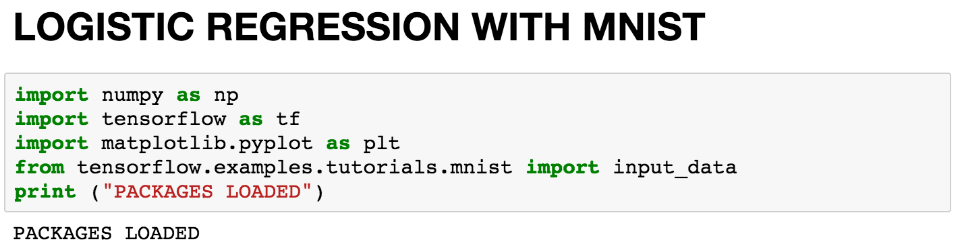
Notes:
import numpy as np
import tensorflow as tf
import matplotlib.pyplot as plt
from tensorflow.examples.tutorials.mnist import input_data
print ("PACKAGES LOADED")

Slide 19
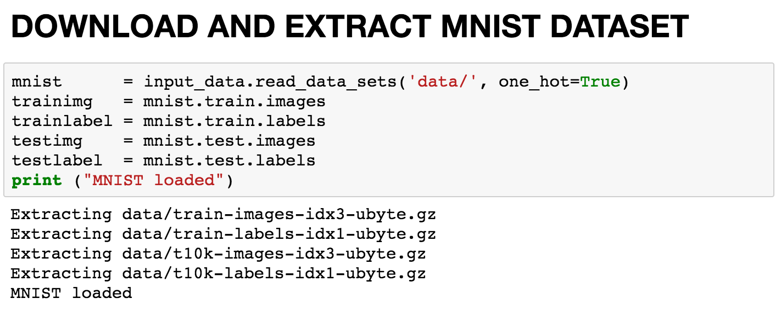
Notes:
mnist = input_data.read_data_sets('data/', one_hot=True)
trainimg = mnist.train.images
trainlabel = mnist.train.labels
testimg = mnist.test.images
testlabel = mnist.test.labels
print ("MNIST loaded")

Slide 20
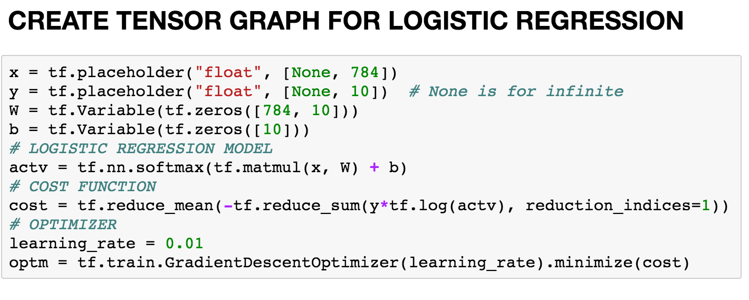
Notes:
x = tf.placeholder("float", [None, 784])
y = tf.placeholder("float", [None, 10]) # None is for infinite
W = tf.Variable(tf.zeros([784, 10]))
b = tf.Variable(tf.zeros([10]))
# LOGISTIC REGRESSION MODEL
actv = tf.nn.softmax(tf.matmul(x, W) + b)
# COST FUNCTION
cost = tf.reduce_mean(-tf.reduce_sum(y*tf.log(actv), reduction_indices=1))
# OPTIMIZER
learning_rate = 0.01
optm = tf.train.GradientDescentOptimizer(learning_rate).minimize(cost)

Slide 21
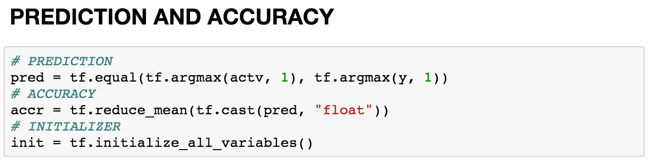
Notes:
# PREDICTION
pred = tf.equal(tf.argmax(actv, 1), tf.argmax(y, 1))
# ACCURACY
accr = tf.reduce_mean(tf.cast(pred, "float"))
# INITIALIZER
init = tf.initialize_all_variables()

Slide 22
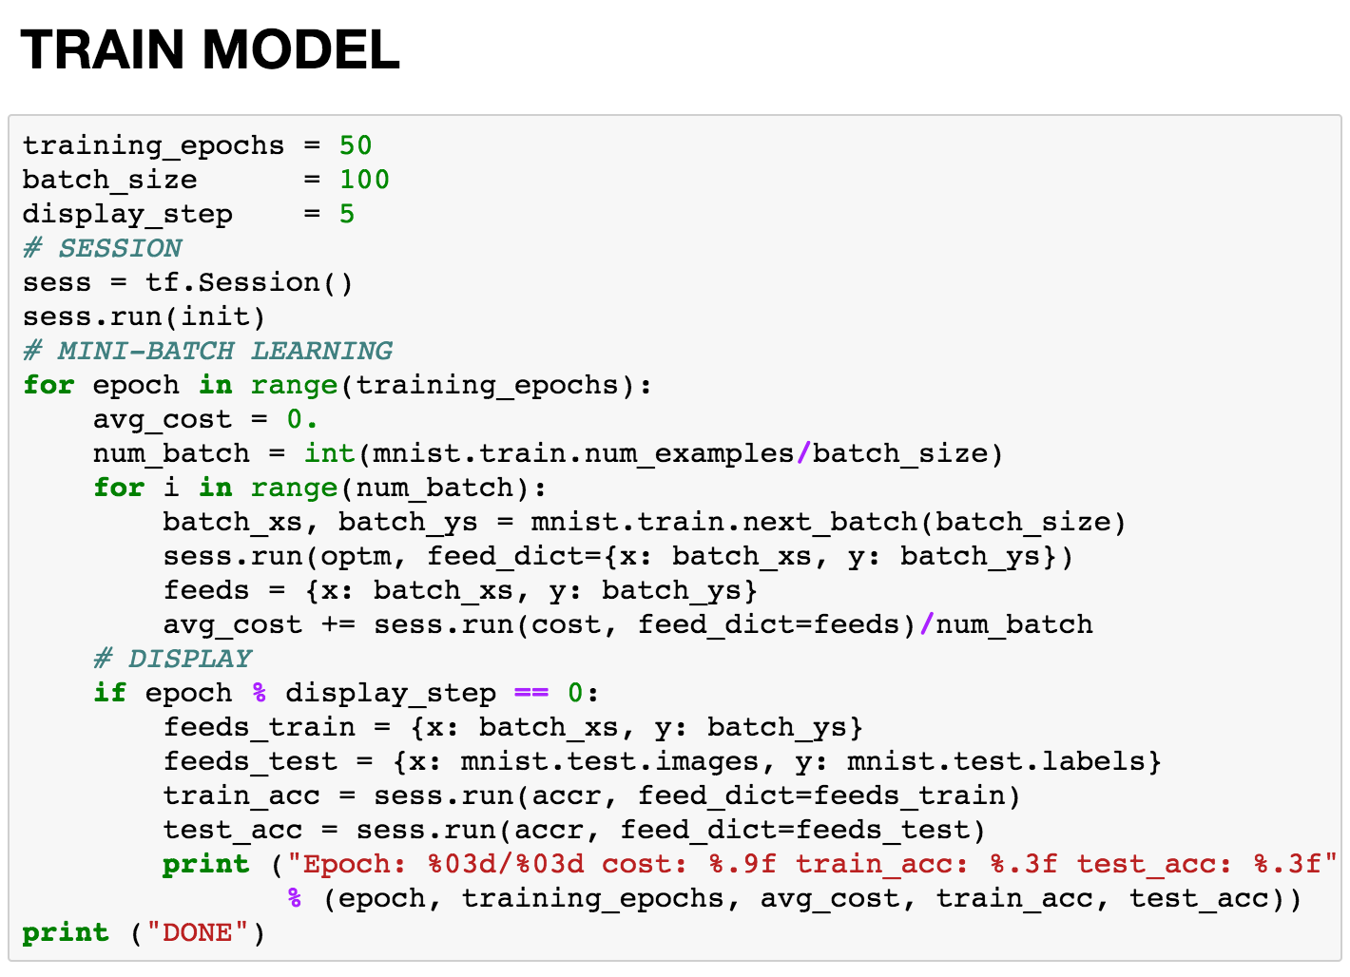
Notes:
training_epochs = 50
batch_size = 100
display_step = 5
# SESSION
sess = tf.Session()
sess.run(init)
# MINI-BATCH LEARNING
for epoch in range(training_epochs):
avg_cost = 0.
num_batch = int(mnist.train.num_examples/batch_size)
for i in range(num_batch):
batch_xs, batch_ys = mnist.train.next_batch(batch_size)
sess.run(optm, feed_dict={x: batch_xs, y: batch_ys})
feeds = {x: batch_xs, y: batch_ys}
avg_cost += sess.run(cost, feed_dict=feeds)/num_batch
# DISPLAY
if epoch % display_step == 0:
feeds_train = {x: batch_xs, y: batch_ys}
feeds_test = {x: mnist.test.images, y: mnist.test.labels}
train_acc = sess.run(accr, feed_dict=feeds_train)
test_acc = sess.run(accr, feed_dict=feeds_test)
print ("Epoch: %03d/%03d cost: %.9f train_acc: %.3f test_acc: %.3f”
% (epoch, training_epochs, avg_cost, train_acc, test_acc))
print ("DONE")

Slide 23
